Slide 1
GEHC SDT Weekly Status Report
05/03/17

Slide 2
Open Actions
Action item | Owner | Forum | Expected Closure Date | Actual Closure Date | Owner Comment | Status
Mobility Team or tiger team to be formed to resolve all CLICK mobile issues. | Rohit/Gopi | Jan’ 17 Workout | TBD |  | On monitoring the debug logs: Two incidents have been raised and CLICK team is working on fix. | In Progress
Performance issues: SDT Booking and Architecture Assessment. | Hita/Andrey/Urmila/Chandra | Jan’ 17 Workout | TBD |  | Use local database for optimizing click calls - POC | Open
Ownership on Tickets/Process adherence(Agile Mechanism) | Suvarna/Sathyaraj | Jan’ 17 Workout | Ongoing |  |  | In Progress
GEHC to check and confirm on L1 support - on call support | Chandra/CG | Jan’ 17 Workout | TBD |  | No services available in ServiceNow tool. Exploring other opportunities | In Progress

Slide 3
Weekly Snapshot – 05/03/17
Health of the Engagement
Highlights
Weekly Master data uploaded successfully
CRP environment is up and started with Integration testing for all the R2 functional user stories.
Backlog refinement and Iteration4 retrospectives completed successfully
GREEN
Risk / Issues / Challenges
Help Needed
Issues in comprehending data flow due to unavailability of CLICK environment details - Rohit
Unavailability of MT analyzer tool access will lead to difficulties in viewing of messages (Request & Response) for all the CLICK environment – Paul/Gopi
Frequent roll back of CLICK changes implemented in production will lead to productive loss of resources - GE
Need clarity on the responses received related to webservers, latency, timing, frequency of patches and domain policies on server infrastructure related queries - Chandra

Slide 4
Focus Area Updates
Focus Areas | Owner | Status | Comments
Mobile Sync Issues | CG Team | In Progress | Yet to receive end to end environments details from CLICK team denied due to policy reasons Two incidents have been raised from European region and CLICK team working on fix For APAC region no mobile sync issues identified.
SDT Booking Performance Issues | CG Team | In Progress | CRP environment is up and Integration Testing for all the R2 performance user stories is in progress.
Release Management | CG Team | Ongoing | Release check list was created and it is updated in our Release readiness check call.
Incident Management | CG Team | Ongoing | Streamlining incidents w.r.t CLICK support cases Problem ticket creation process finalized. Incidents reported in this week are closed.
Support and Development Process streamlining | CG Team | Ongoing | Agile metrics identified and tracked through Rally. Ensuring all email communication to have incident ticket created. Internal defect tracker is maintained to track the QA/UAT defects and owners defined for each defect.

Slide 5
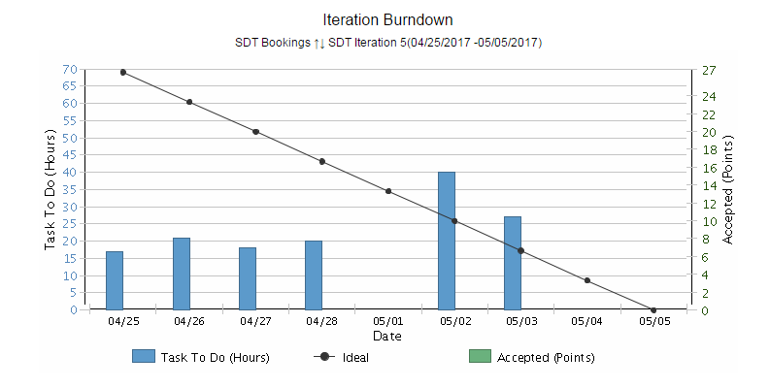
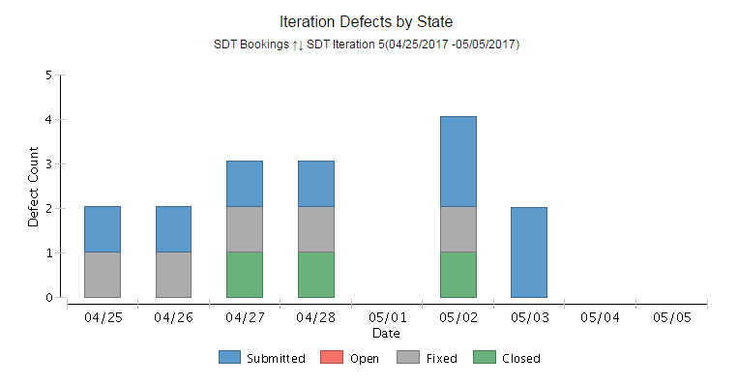
Weekly Snapshot & Agile Metrics – SDT Development
Release 2
Iteration 5 Burndown Chart
Health of the Egagement
SDT Iteration 3 -(03/21/2017 -03/31/2017) -Completed
SDT Iteration 4 -(04/05/2017 -04/19/2017 –Completed
Iteration review: 04/24/2017 -Completed
Backlog refinement : 04/26/2017 -Completed
Iteration 4 retrospectives: 04/26/2017 -Completed
Analysis and feedback Implementation – In progress
Release 2 –Iteration 5 highlights
Committed User Stories for Iteration 4 :12
Testing –Completed for completed user stories in local environment.
Started integration Testing in CRP for all the R2 functional user stories.
Received feedback/suggestions on the demonstrated user stories and added that as an backlog item in Rally.
We have done Analysis on few points suggested by PO and shared the same with them.
Received confirmation on suggestions added that in middle of the sprint..
Defects are tracking through rally.
Impediments
Getting error while launching SDT from Itest environment.
Need Siebel ITest access for testing team.
Iteration 5 Defect by State
Risk / Issues / Challenges
Help Needed

Slide 6
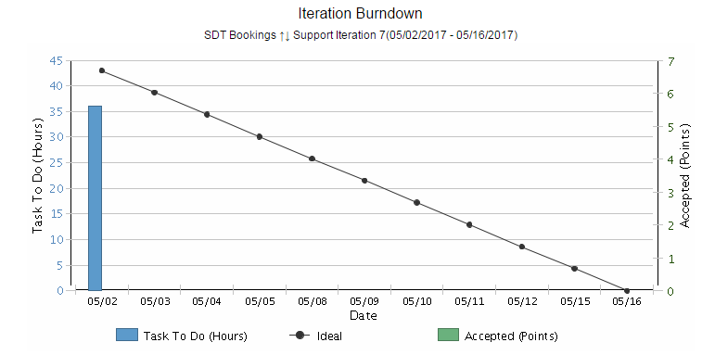
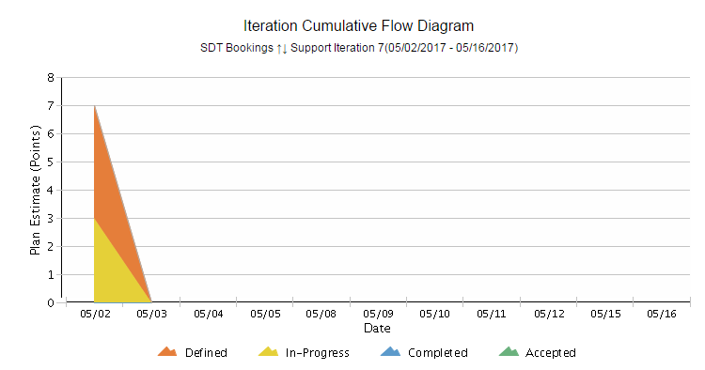
Agile Metrics - Support
Support Iteration 7 (05/02/2017 - 05/16/2017)
Burndown chart
Inferences
Iteration Support Burndown Chart:
Support activities keep on added up on a daily basis based on the support tickets that we receive. Hence there’s a mismatch with ideal.
End of the sprint, all tickets are closed and all the user stories are accepted by Product owner.
Iteration Cumulative Flow Diagram
The tasks related to R2.4 Deployment are in define state because of awaiting confirmation from Click.
Weekly master data load has been completed.
2 incidents are in progress.
Cumulative Flow Diagram

Slide 7

Agile Metrics – SDT Booking Velocity Chart
SDT
Inferences- Velocity Chart
SDT Iteration 1
Velocity of team:50 story points
Accepted By PO: 13 story Points
US85 and US 97 –Accepted by PO as these user stories are already deployed in production as part of release 1.3.1
Iteration length: 10 days(2 weeks)
SDT Iteration 2
Velocity of team: 9 story points
Accepted By PO: 9 story Points
Iteration length: 5 days(1 week)
SDT Iteration 3
Velocity of team: 20 story points
Accepted By PO: 17 story Points
Iteration length: 8 days
SDT Iteration 4
Velocity of team: 60 story points
Accepted By PO: 49 story Points
Iteration length: 14 days

Slide 8
Agile Metrics – Support Velocity Chart
Inferences-Velocity Chart
Support
Support Iteration 1
Velocity of team:5 story points
Accepted By PO: 5 story Points
Iteration length: 8 days
Support Iteration 2
Velocity of team:20 story points
Accepted By PO: 19 story Points
Iteration length: 12 days
Support Iteration 3
Velocity of team:20 story points
Accepted By PO: 20 story Points
Iteration length: 11 days
Support Iteration 4
Velocity of team:17 story points
Accepted By PO: 17 story Points
Iteration length: 11 days
Support Iteration 5
Velocity of team:20 story points
Accepted By PO: 12 story Points
Iteration length: 10 days
Support Iteration 6
Velocity of team::9 story points
Accepted By PO: 12 story Points
Iteration length: 10 days

Slide 9
Agile Metrics – Resource Utilization
Iteration 5 (24th Apr 2017 – 5th May 2017)

Slide 10
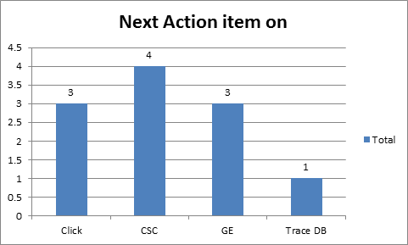
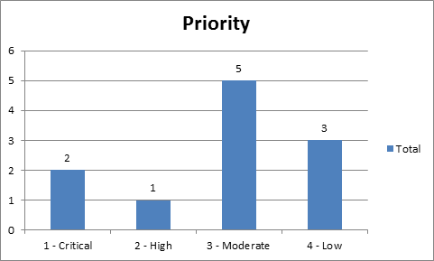
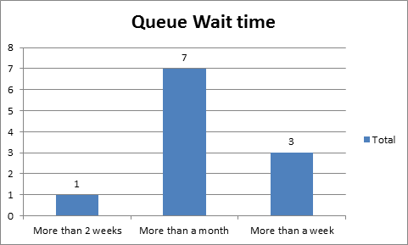
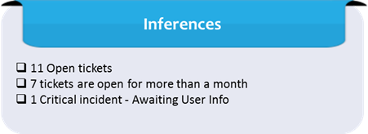
Incident Update
Inferences

Slide 11
Incident Tickets
Incident Management
Incident # | Module | Key Words | Next Action item | Next Action item on | Priority | Status | Date | Queue Period
INC1477114 | SDT Mobile | Mobile Sync Issue | Paul Han | GE | 4 - Low | Awaiting User Info | 2017-02-06 22:07:53 | More than a month
INC1480772 | SDT Mobile | Mobile sync Issue | Paul Han | GE | 4 - Low | Awaiting User Info | 2017-02-07 22:44:28 | More than a month
INC1738700 | SDT Module | Click Issue | Meera S | CSC | 3 - Moderate | Awaiting 3rd Party | 2017-03-02 23:23:56 | More than a month
INC1747182 | SDT Mobile | Click Issue | Ravi Pratap Singh | Click | 3 - Moderate | Awaiting 3rd Party | 3/7/2017 4:40 | More than a month
INC1777886 | SDT Module | Click Issue | Simon A | CSC | 3 - Moderate | Awaiting 3rd Party | 2017-03-20 12:29:37 | More than a month
INC1779626 | SDT Module | Click Issue | Ravi Pratap Singh | Click | 3 - Moderate | Awaiting 3rd Party | 2017-03-21 03:24:05 | More than a month
INC1795381 | SDT Module | SDT Booking issue | Rohit Handa | GE | 3 - Moderate | Active | 3/27/2017 1:42 | More than a month
INC1840513 | Click | Click Issue | Ravi Pratap Singh | Click | 2 - High | Awaiting 3rd Party | 2017-04-17 20:06:59 | More than 2 weeks
INC1849680 | Click | Click Issue | Dian Ayu | CSC | 1 - Critical | Awaiting User Info | 2017-04-21 01:06:50 | More than a week
INC1856638 | Click | Click Issue | Haritha G | Trace DB | 4 - Low | Awaiting 3rd Party | 2017-04-24 23:52:26 | More than a week
INC1856850 | SDT Module | SDT Booking issue | JohnDavid Q | CSC | 1 - Critical | Awaiting User Info | 2017-04-25 01:00:13 | More than a week

Slide 12
THANK YOU

